Slide 1
iSearch+
Smart News Search Engine
Group Members: Yifan Wang, Qi Jiang, Jingyang Guo

Slide 2



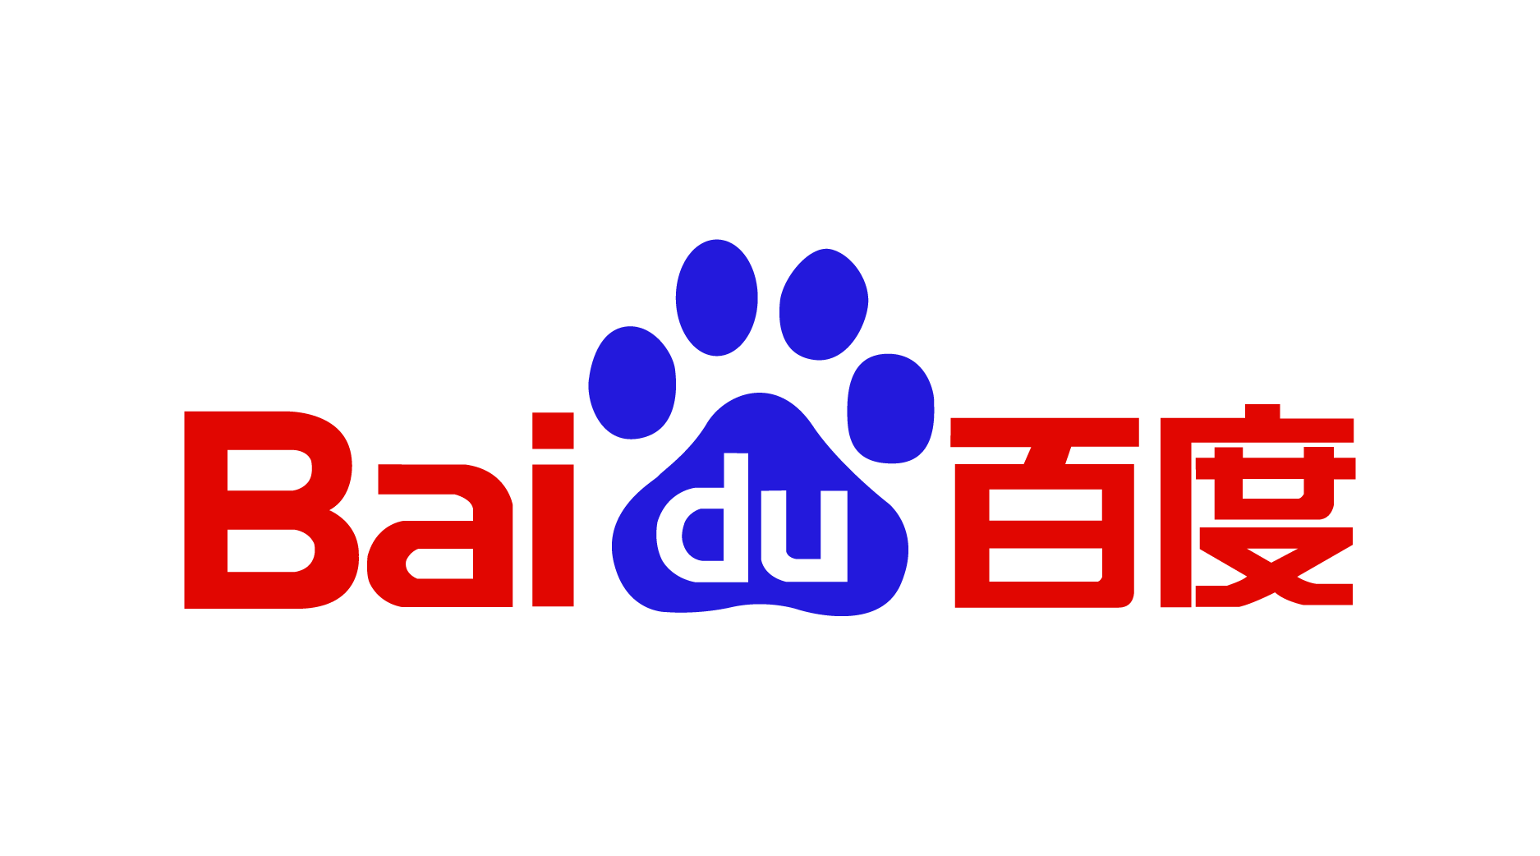

Search Engines

Slide 3
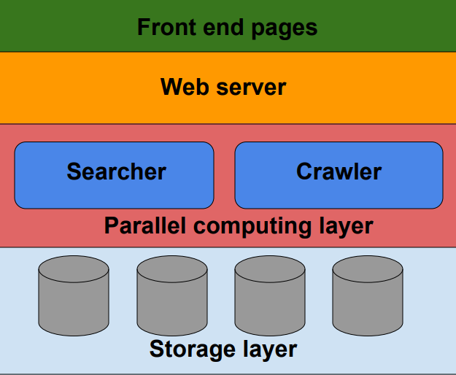
Overall architecture
Front end
Web server
Parallel layer
Storage

Slide 4
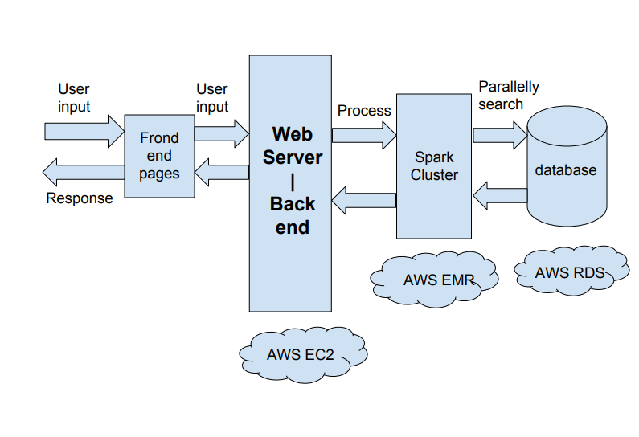
Main flowchart

Slide 5




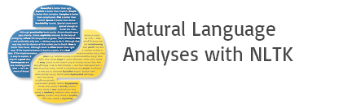
Technique Stack

Slide 6



Modules - Front end

Slide 7

Modules - Front end

Slide 8
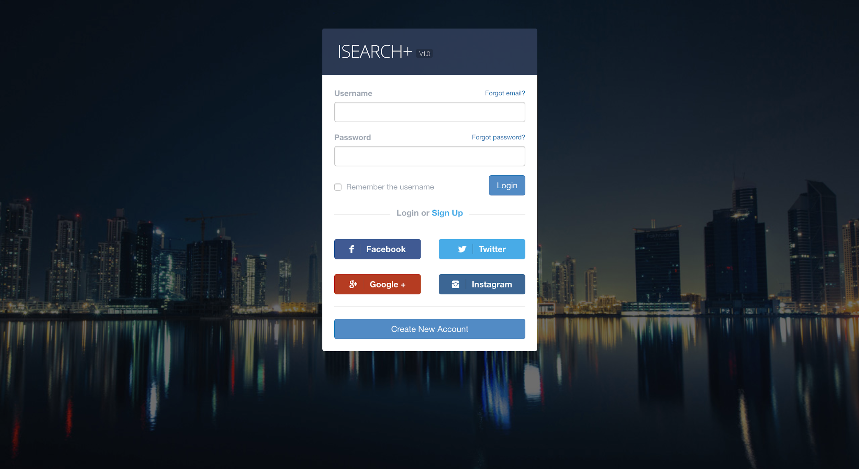
Modules - Front end

Slide 9
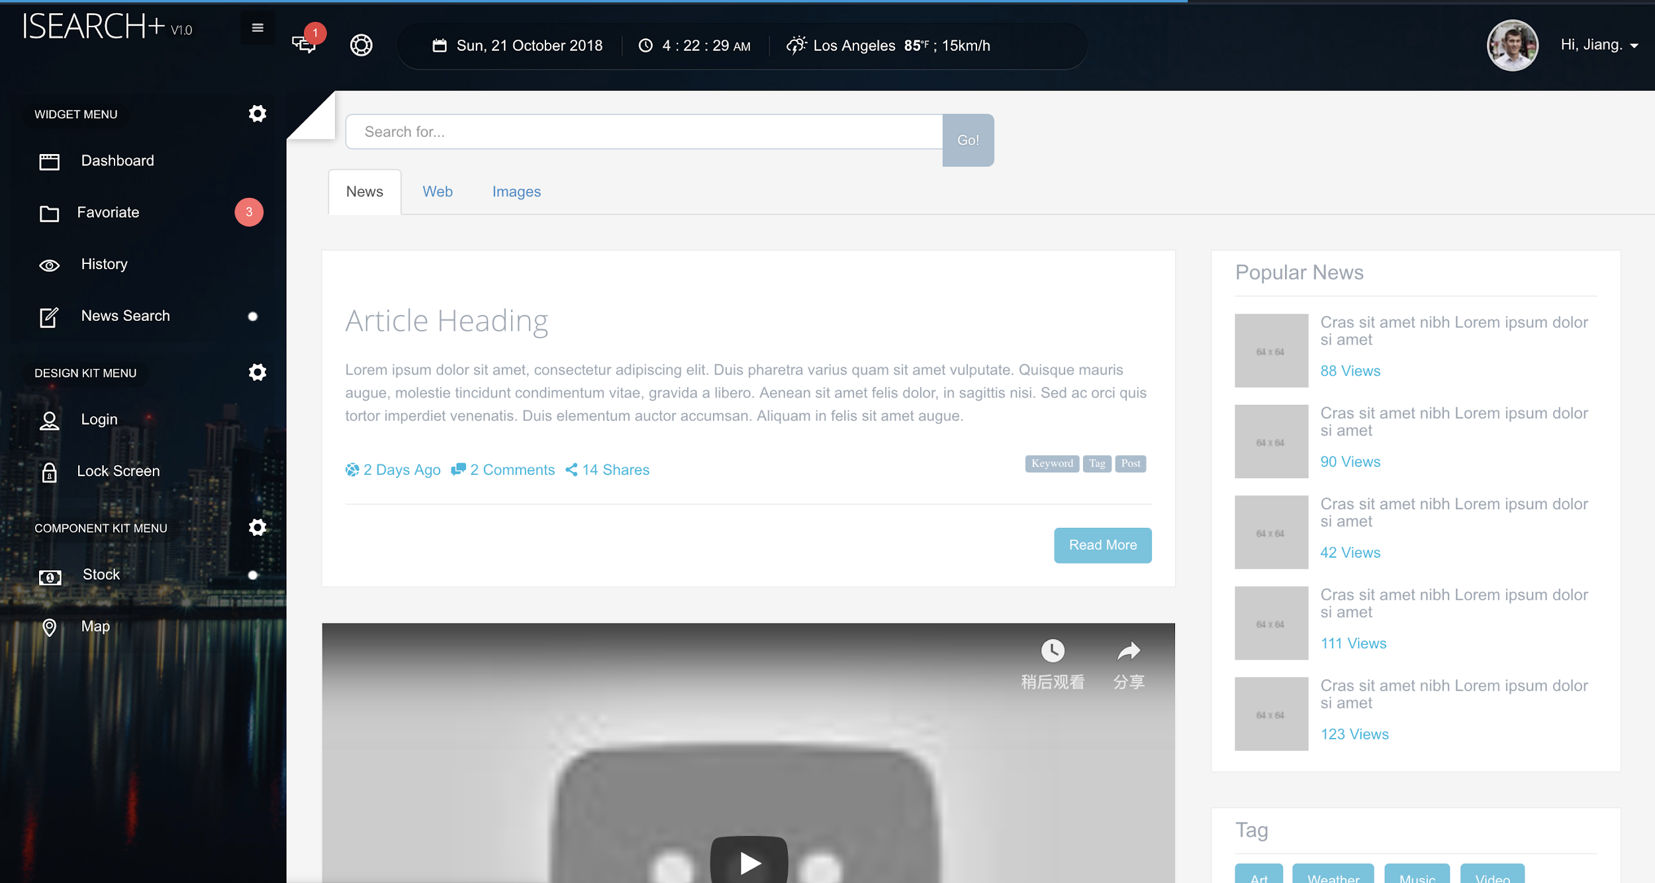
Modules - Front end

Slide 10
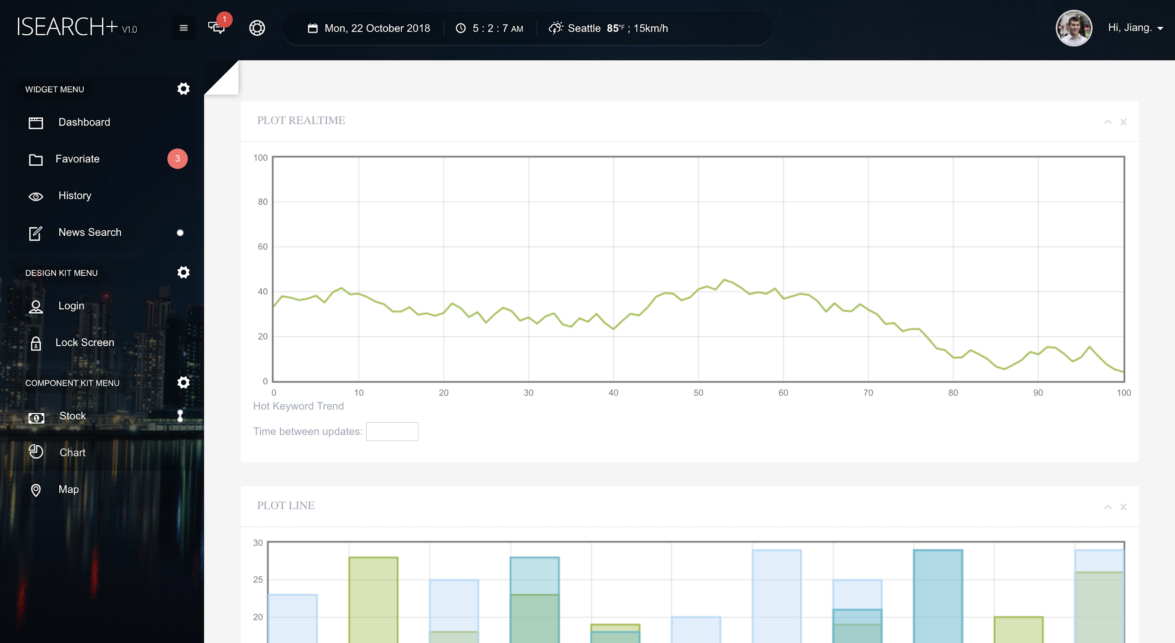
Modules - Front end
“Data Visualization”

Slide 11
Modules - Web server
Framework: Python Tornado
Deployed platform: AWS EC2
Reverse proxy: Nginx

Slide 12

Modules - Web server
Why Tornado?
Real-time web server:
Tornado was built to support async operations, even earier than Python!
Tornado: Real Time Web Server

Slide 13
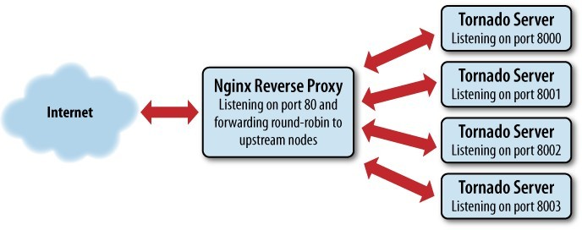
Modules - Web server
Why Nginx?
Isolate front end and back end more clearly.
Load balance
Simpler to filter data stream

Slide 14
Modules - Crawler
Typical parallel computing issue:
News sources and articles have no relationship with each other.
2. Use multi-threaded technique to speed up crawling

Slide 15
Modules - Crawler
Typical parallel computing issue:
News sources and articles have no relationship with each other.
2. Use multi-threaded technique to speed up crawling

Slide 16
Modules - Searcher
Parellel
Look up inverted index table
Sort the document
Present to users

Slide 17

Modules - Storage
Amazon RDS
Inverted index table
Documents
User data
User data
...

Slide 18
References
[1] Brin S, Page L. The anatomy of a large-scale hypertextual web search engine[J]. Computer networks and ISDN systems, 1998, 30(1-7): 107-117.
[2] Thelwall M. A web crawler design for data mining[J]. Journal of Information Science, 2001, 27(5): 319-325.
[3] Paramkusham S. NLTK: THE NATURAL LANGUAGE TOOLKIT[J].
[4] Sauls C, Leithead T, Tokumi R. Synonym and similar word page search: U.S. Patent 7,822,763[P]. 2010-10-26.
[5] Zaharia, Matei, et al., ``Spark: Cluster computing with working sets.'', HotCloud 10.10-10 (2010): 95.
[6] Isele, Robert, et al. "LDspider: An open-source crawling framework for the Web of Linked Data." 9th International Semantic Web Conference (ISWC2010). 2010.

Slide 19
References
[7] Kreps, Jay, Neha Narkhede, and Jun Rao. "Kafka: A distributed messaging system for log processing." Proceedings of the NetDB. 2011.
[8] Ranjan, Rajiv. "Streaming big data processing in datacenter clouds." IEEE Cloud Computing 1.1 (2014): 78-83.
[9] Pang, Bo, and Lillian Lee. "Opinion mining and sentiment analysis." Foundations and Trends® in Information Retrieval 2.1–2 (2008): 1-135.
[10] Alexander, Carol. Market models: A guide to financial data analysis. John Wiley \& Sons, 2001.
[11] Brin, Sergey, and Lawrence Page. "The anatomy of a large-scale hypertextual web search engine." Computer networks and ISDN systems 30.1-7 (1998): 107-117.
[12] Lei, Yuangui, Victoria Uren, and Enrico Motta. "Semsearch: A search engine for the semantic web." International Conference on Knowledge Engineering and Knowledge Management. Springer, Berlin, Heidelberg, 2006.

Slide 20
Thank you

